Slide 1
Illusive Fitness
O’Callaghan Gym

Slide 2
Why are we here?
To improve experience of beginners in the gym.
Extend knowledge of intermediate to advanced lifters.
A platform where you can discover exercises, meal plans, stretches and much more.
The main purpose of this project is to create a website which can help extend the knowledge of its users regarding anything fitness related.

Slide 3
The elevator pitch
For anybody that loves to exercise who wants to gain more knowledge in what exercises work best for certain areas.
The Illusive Fitness is a Fitness Website that has an interactive muscle map to help you identify which workouts will target the selected muscle along with other useful features.
Unlike other fitness websites our project is beneficial to all audiences, whether you have never lifted before or you are a professional bodybuilder, no body is doing what we will do.

Slide 4

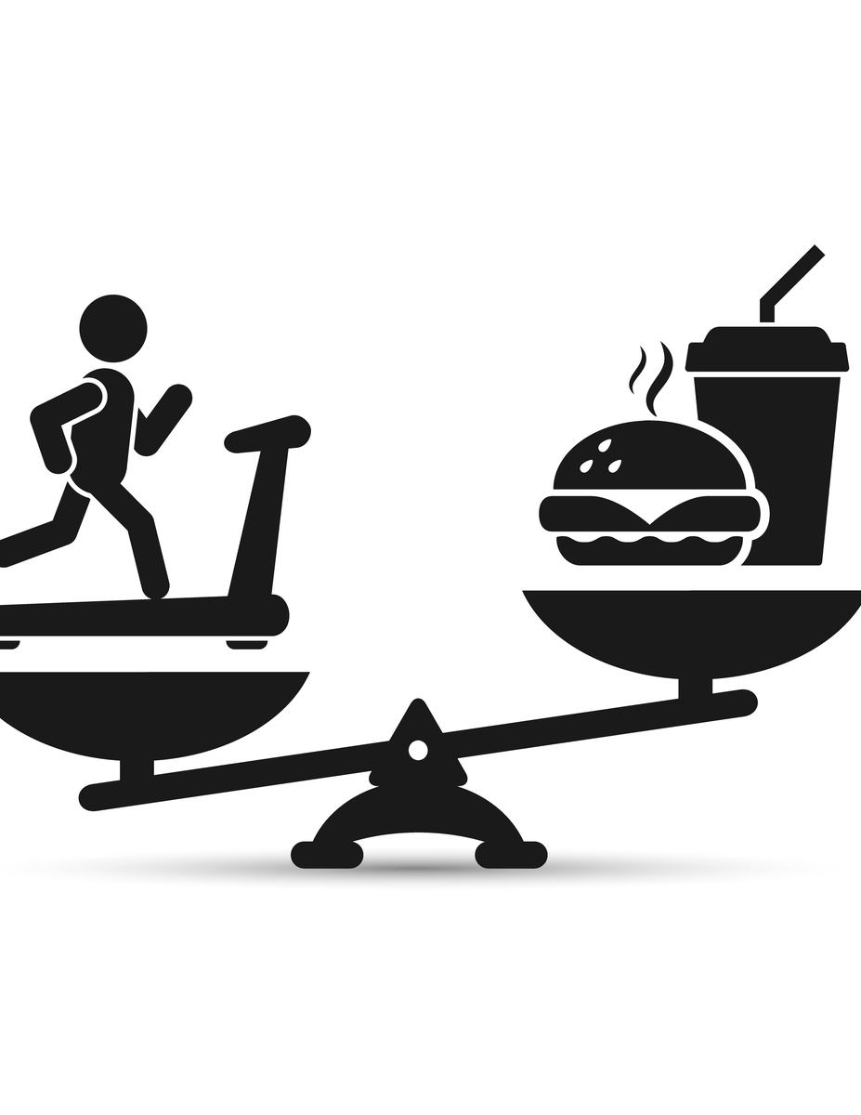
Product Box
ILLUSIVE FITNESS
Slogan: Make yourself stronger than your excuses.
Benefit 1: Introduce begins to the simplicity and brilliance of a healthy life style.
Benefit 2: Share knowledge and tips to all levels of gym goers.
Benefit 3: We elaborate on exercises that may produce injuries to eliminate the danger.

Slide 5
The NOT list
IN | OUT
Meal Plans | Exercises to Avoid
Exercises specific to each muscle group | Foods to Avoid
Exercises specific for weight loss | Training supplements
Exercises specific for strength training | Fasting and other diet types
Useful Training equipment to prevent injury
UNRESOLVED
Types of stretches
Cardio Training
Gym equipment you can purchase.
Notes:
List all the big ticket items you are (and are NOT) going to deliver within the scope of this project.
Before starting your project move all the UNRESOLVED ones to either IN or OUT.

Slide 6


Our Project Community
System Analyst
Users
Our Core team
Graphic Designers
Customers

Slide 7
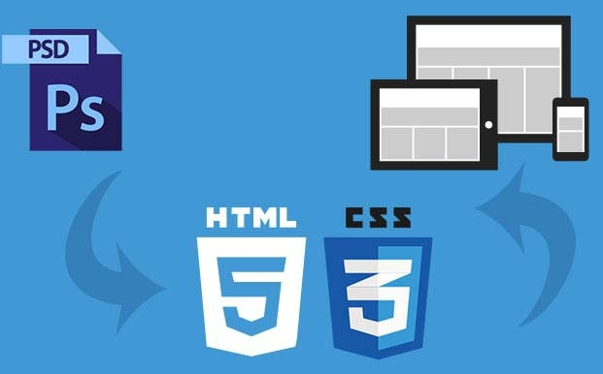
Technical Solution
Technologies:
-Language: HTML, CSS
-Libraries: HTML API’s
-Technology: Jira Atlassian

Slide 8
What keeps us up at night
Sponsors will only commit to project if it exceeds quality expectations.
Must be complete within the specified deadline.
Customer changes their requirements deep into the project.
Unrealistic deadlines and project requirements.

Slide 9
The A-Team
# | Role | Competencies/Expectations
1 | Analyst | Comfortable with just in time analysis
2 | Developers | HTML,CSS, Javascript , Xamarin , C , Java
3 | Scrum Master | Responsible for keeping the team on track with deadline. Organises team meetings and communicates with the owner.
4 | Tester | Looks for Bugs in developers code and ensures application is of high quality

Slide 10

Scope of the project
Ship it!
Construction
UAT
Training
10 weeks
2 weeks
5 days
Rough estimation of time frame to complete project.
Notes:
Give your sponsors some idea of how big this thing is (1, 3, or 6 monther).
Before you can complete this slide you and the team should create and estimate a high-level story list for the project.
This isn’t a commitment (too many unknowns). It’s just a really rough guess. Don’t treat it as anything else.

Slide 11
Trade-off sliders
 | The classic four
 | Feature completeness (scope)
 | Stay within budget (budget)
 | Deliver project on time (time)
 | High quality, low defects (quality)
OFF
ON
OFF
ON
OFF
ON
OFF
ON
 | Other important things
 | Ease of use
 | Don’t make me think!
 | Detailed audits (log everything)
 | Communication between developers and owner.
OFF
ON
OFF
ON
OFF
ON
OFF
ON
Notes:
When push comes to shove, something has to give. Here we want to be clear on what that is.
On agile projects we flex on scope. But there could be others factors at play here so get ready to listen as you customer tells you which forces can bend (scope) and which are written in stone (usually budget).
Slider rules:
1. No two sliders can occupy the same level.
2. List other important project factors down below.

Slide 12

The first release
Ship it!
Construction
UAT
Training
10 weeks
2 weeks
5 days
3 people, 3 ½ months, $250K
Notes:
Stakeholders are usually interested in two things:
How much is this going to cost.
When is it going to be done.
Here we do our best to answer those two questions so they can decide if the project is still worth doing by showing them what it’s going to take.

